Slide 1

ICE 3161
COMMUNICATION ENGINEERING
Dr. Asif Zaman
Professor, CSE, RU

Slide 2
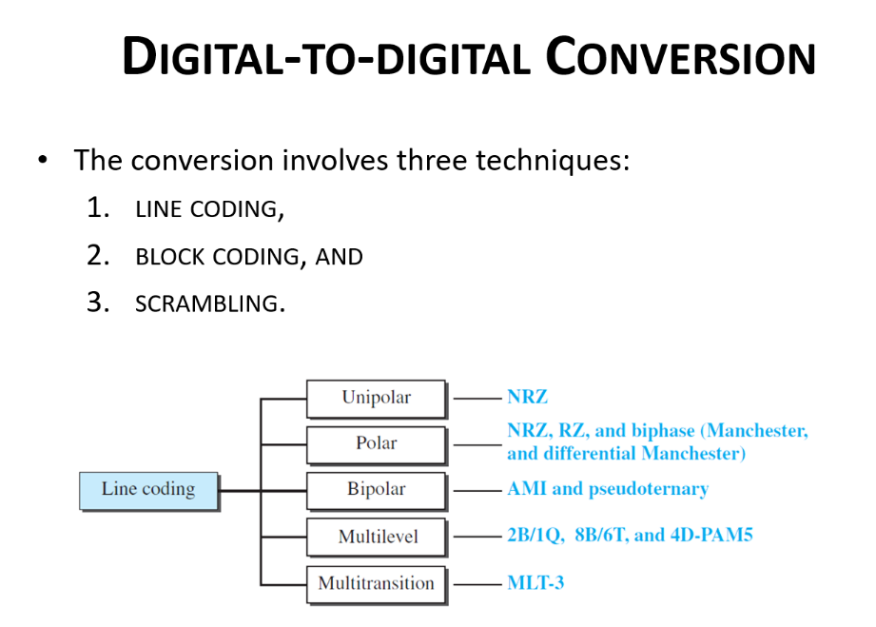
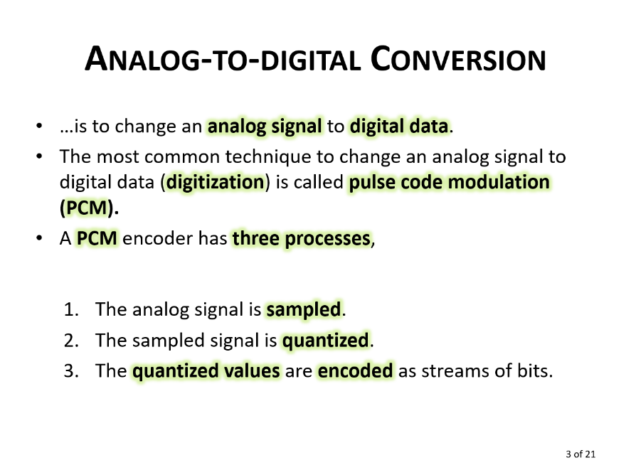
Digital data to Digital Signal Conversion
Analog Signal to Digital Data Conversion
Digital-to-analog Conversion
Digital data to analog Signal Conversion

Slide 3
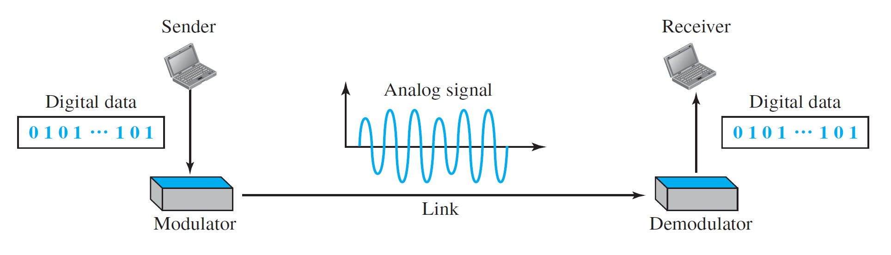
Digital-to-analog Conversion
Digital-to-analog conversion is the process of changing one of the characteristics of an analog signal based on the information in digital data.
a sine wave is defined by three characteristics:
  amplitude, frequency, and phase.

Slide 4
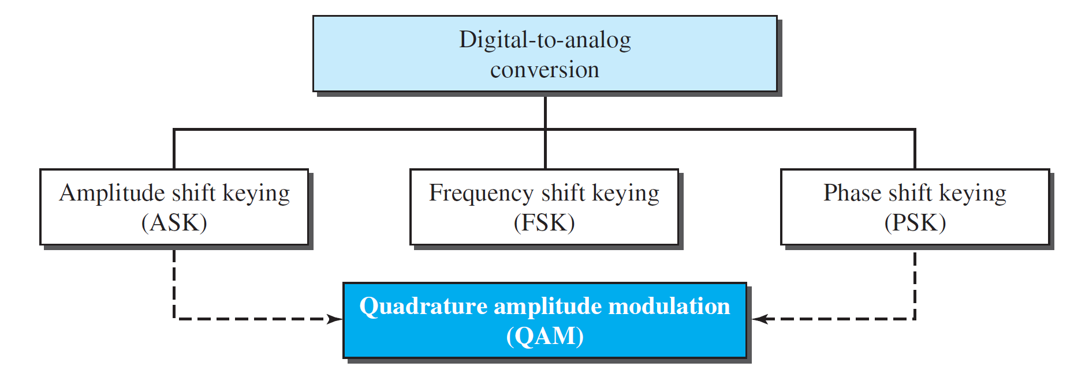
Digital-to-analog Conversion
Two basic issues must be reviewed:
  bit and baud rates
  the carrier signal.

Slide 5
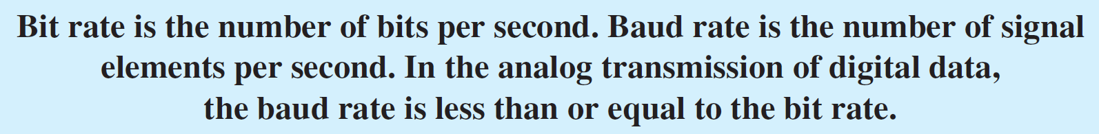
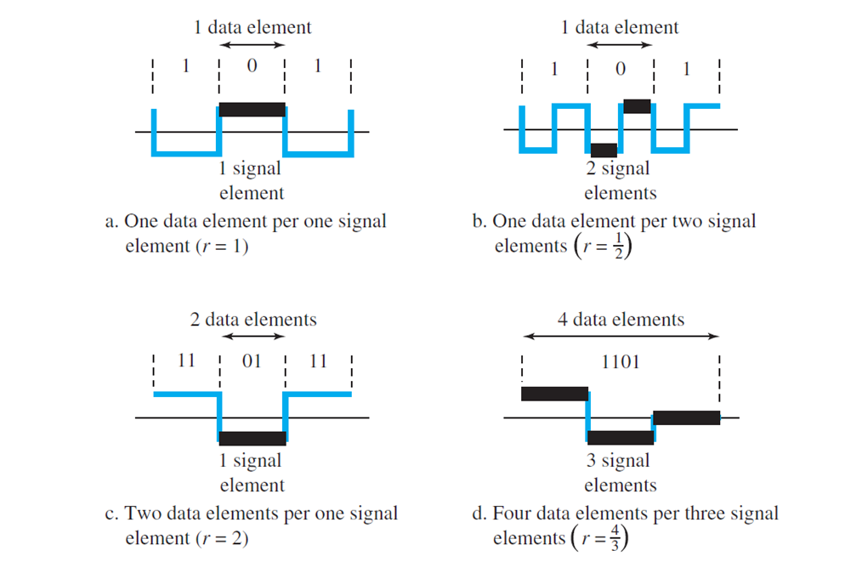
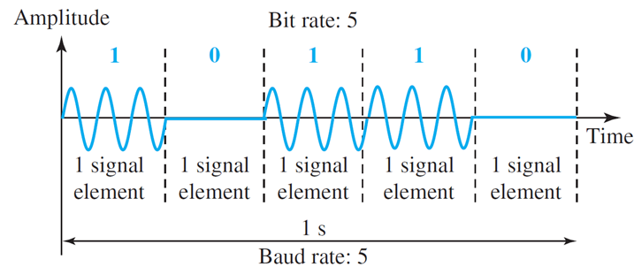

Slide 6
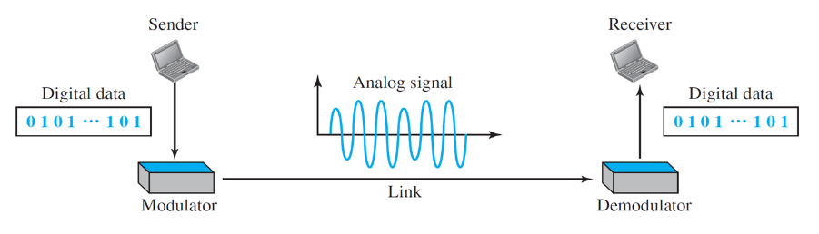
Carrier Signal
  In analog transmission, the sending device produces a high-frequency signal that acts as a base for the information signal.
  This base signal is called the carrier signal or carrier frequency.
  The receiving device is tuned to the frequency of the carrier signal that it expects from the sender.
  Digital information then changes the carrier signal by modifying one or more of its characteristics (amplitude, frequency, or phase).
  This kind of modification is called modulation (shift keying).

Slide 7
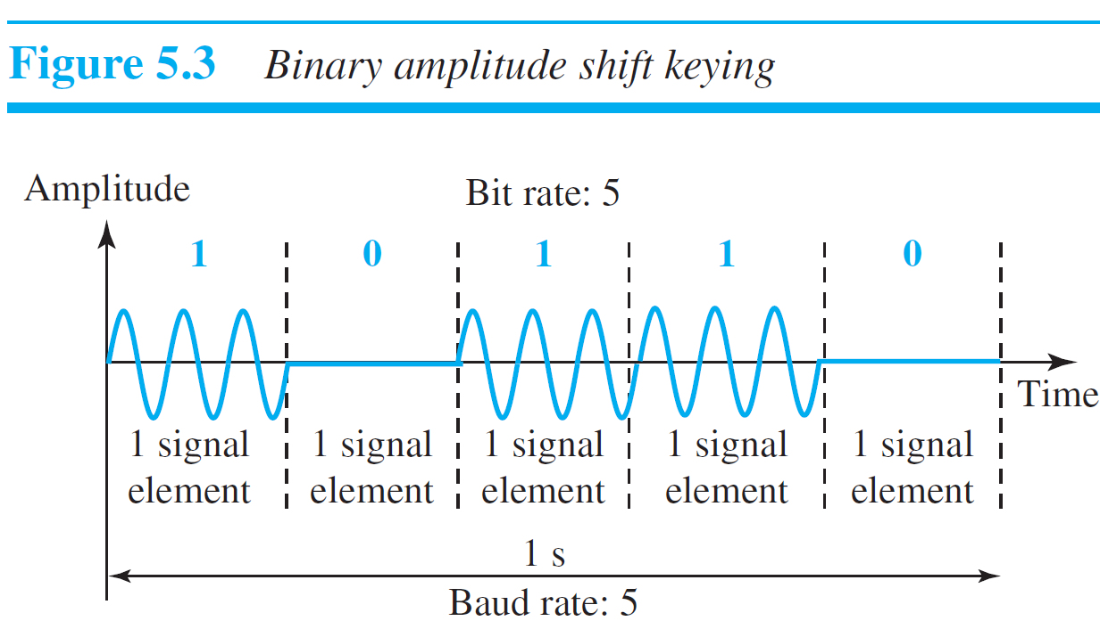
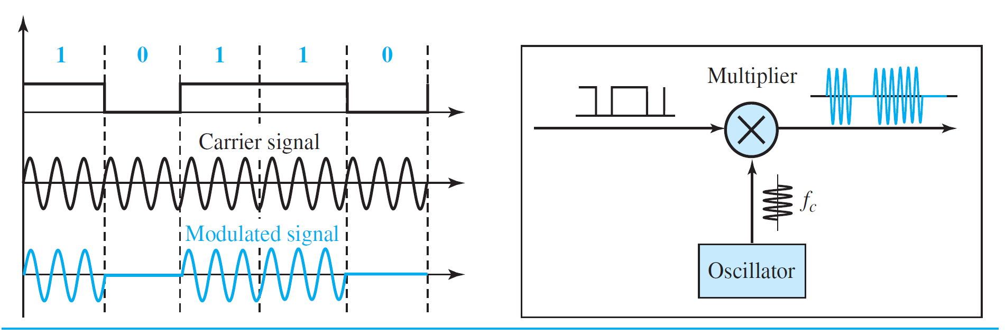
Amplitude Shift Keying
In amplitude shift keying, the amplitude of the carrier signal is varied to create signal elements.
Both frequency and phase remain constant while the amplitude changes

Slide 8
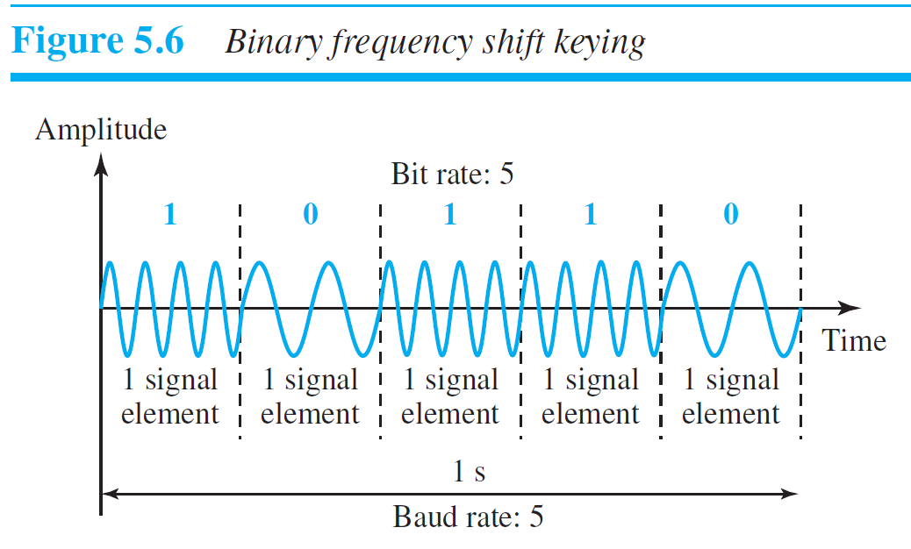
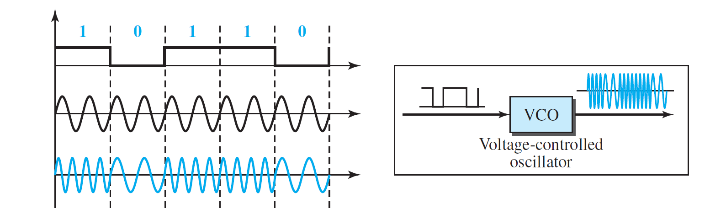
Frequency Shift Keying
In frequency shift keying, the frequency of the carrier signal is varied to represent data.
The frequency of the modulated signal is constant for the duration of one signal element, but changes for the next signal element if the data element changes. Both peak amplitude and phase remain constant for all signal elements

Slide 9
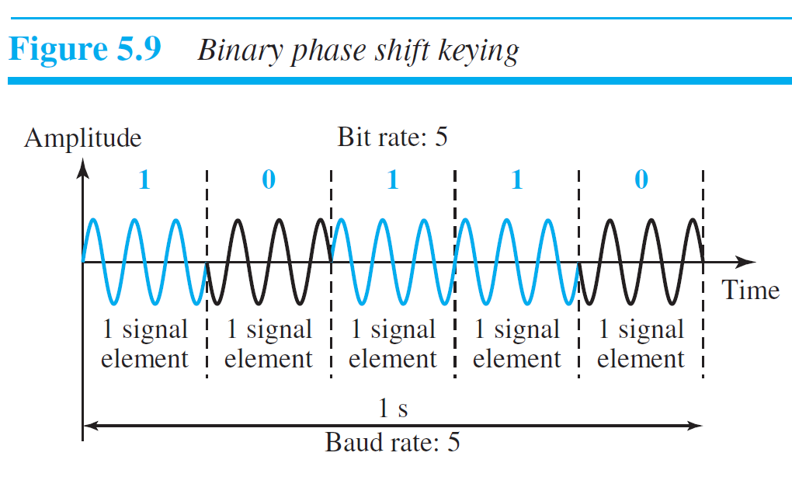
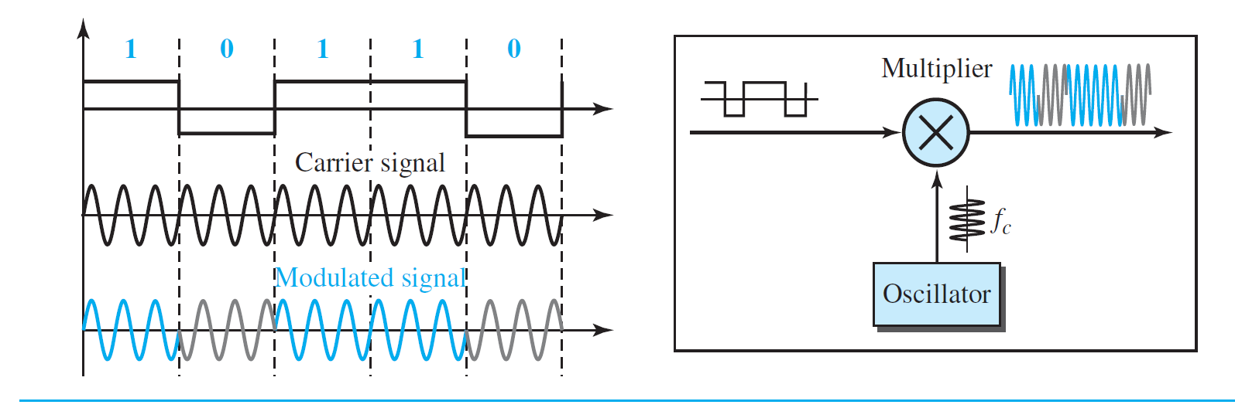
polar NRZ

Slide 10
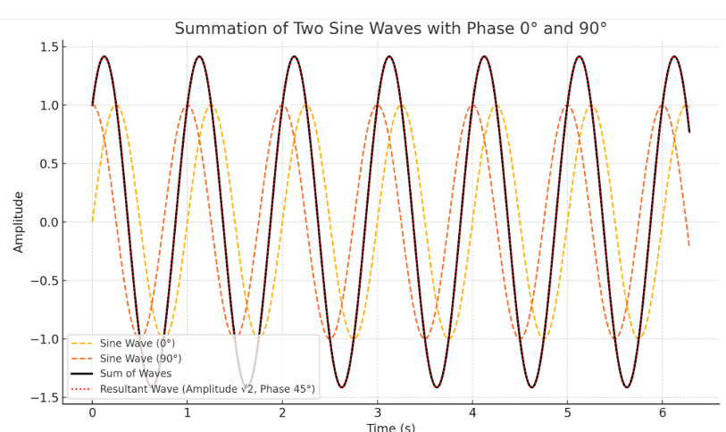
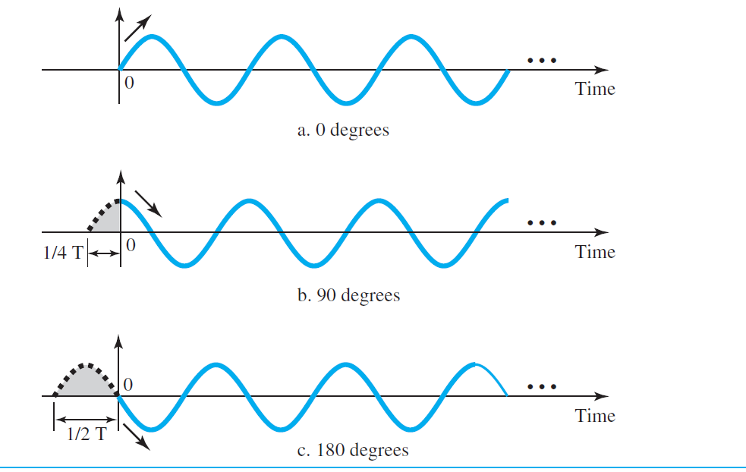
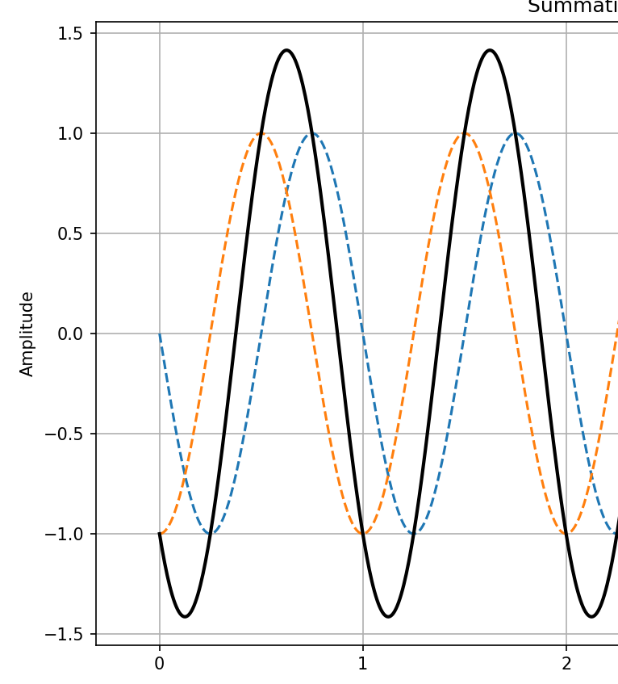
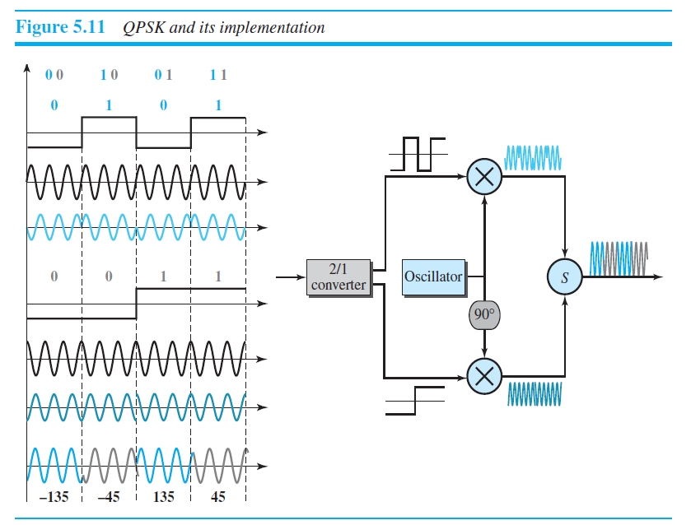

Slide 11
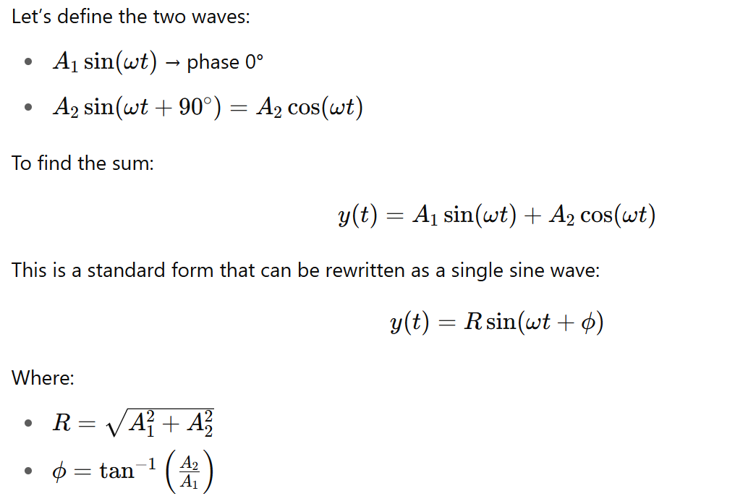
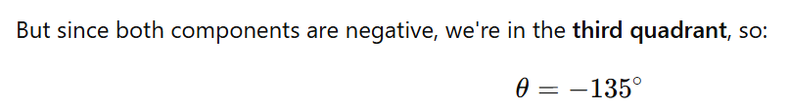
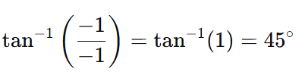
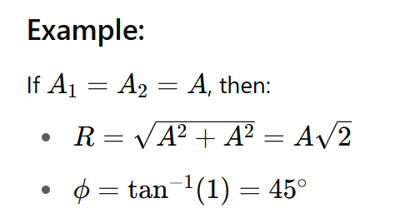
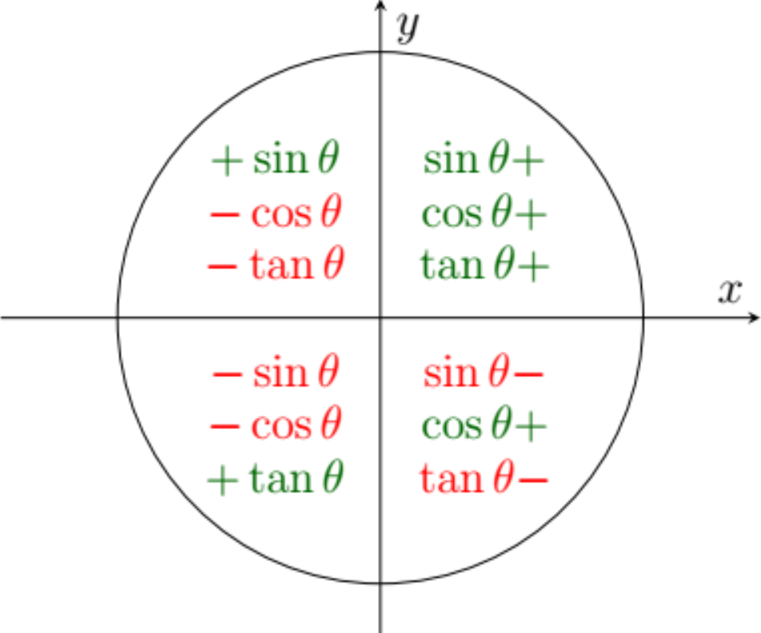
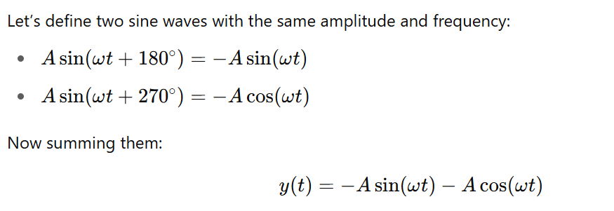

Slide 12
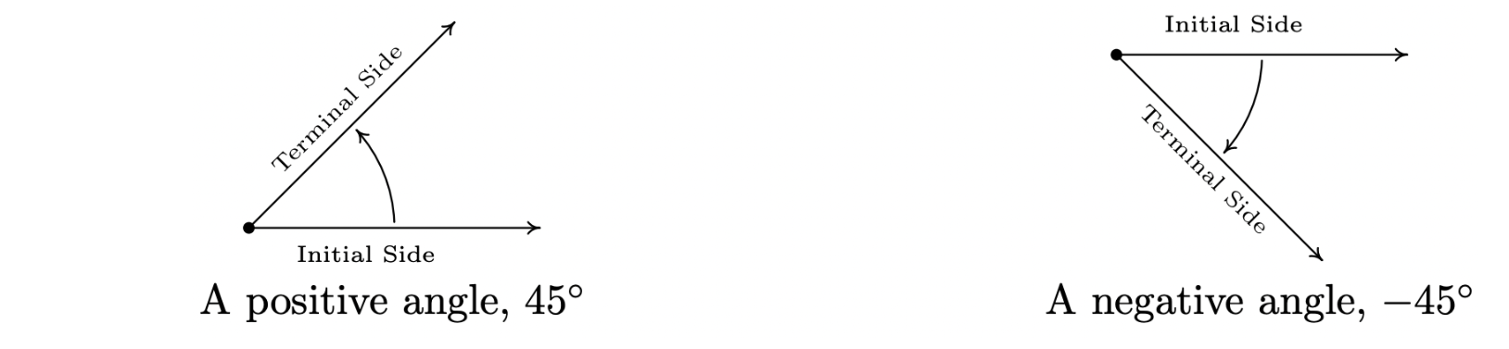
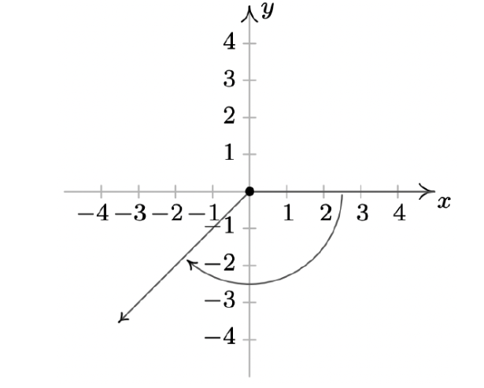

Slide 13

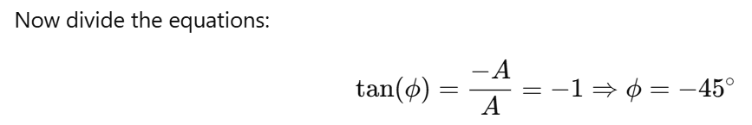
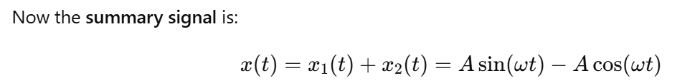
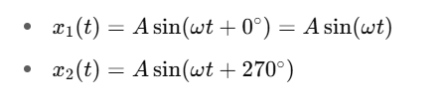
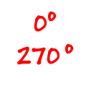

Slide 14
Digital data to Digital Signal Conversion
Analog Signal to Digital Data Conversion
Digital Data to Analog Signal Conversion
Analog-to-analog Conversion
Analog data to analog Signal Conversion

Slide 15
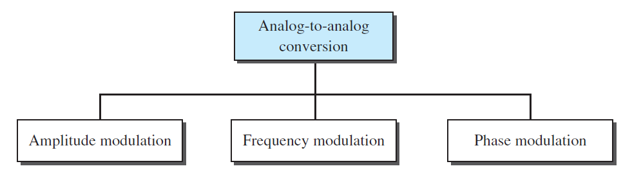
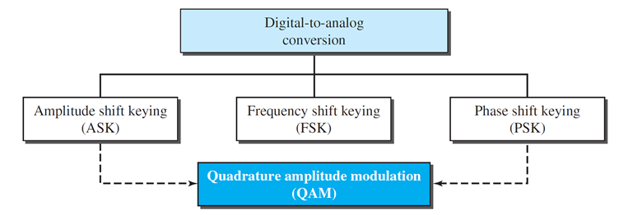
Analog-to-analog Conversion
Analog-to-analog conversion, or analog modulation, is the representation of analog information by an analog signal.

Slide 16
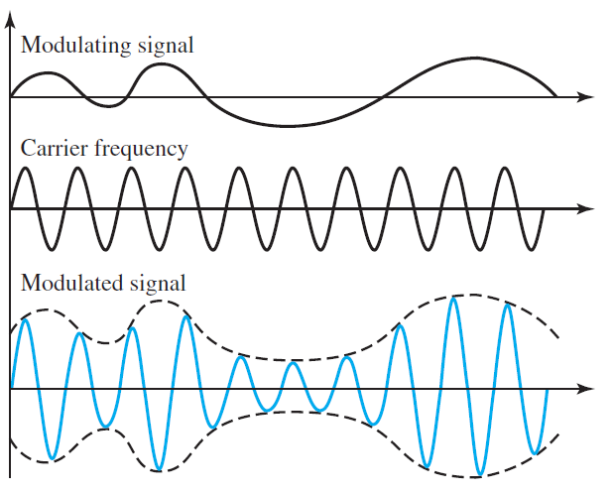
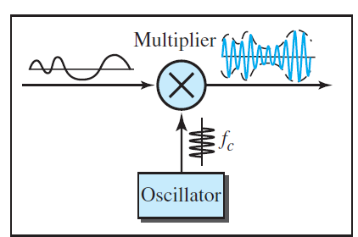
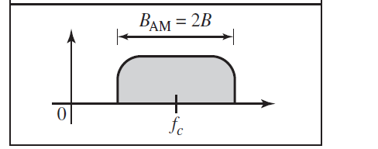
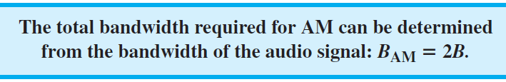
Amplitude Modulation (AM)

Slide 17
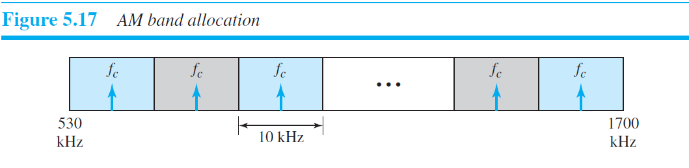
Amplitude Modulation (AM)
The bandwidth of an audio signal (speech and music) is usually 5 kHz.
Therefore, an AM radio station needs a bandwidth of 10 kHz.
AM stations are allowed carrier frequencies anywhere between 530 and 1700 kHz (1.7 MHz).
Federal Communications Commission (FCC)

Slide 18
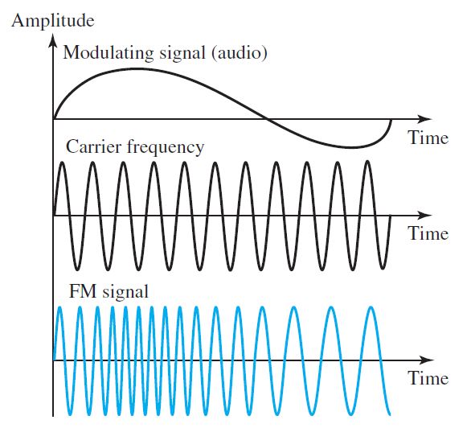
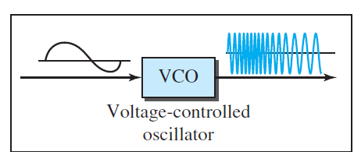
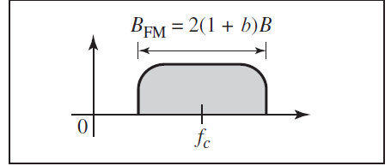
Frequency Modulation (FM)
where β is a factor that depends on modulation technique
with a common value of 4

Slide 19
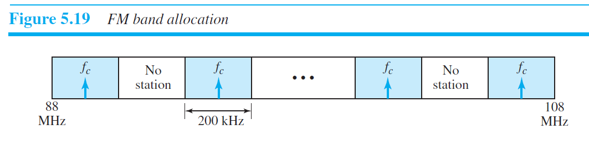
Frequency Modulation (FM)
The bandwidth of an audio signal (speech and music) broadcast in stereo is almost 15 kHz.
The FCC allows 200 kHz (0.2 MHz) for each station.
Stations must be separated by at least 200 kHz to keep their bandwidths from overlapping.

Slide 20
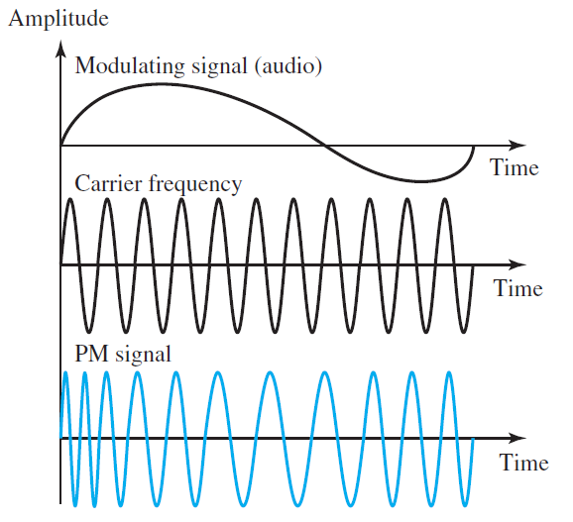
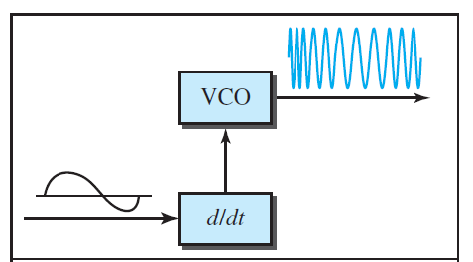
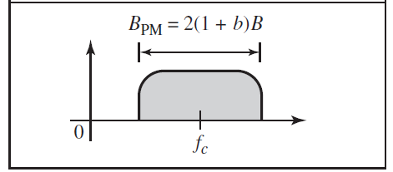
Phase Modulation (PM)

